Slide 1


ABC Call Volume Trend Analysis
Transforming insurance call centers through data-driven customer experience strategies.
by Mohak Shah

Slide 2
The Power of CX Analytics
Data-Driven Decisions
Proactive Improvements
Uncover hidden patterns. Improve customer satisfaction.
Optimize resources. Predict customer needs. Enhance agent performance.
CX analytics drives efficiency. It also ensures happier customers.

Slide 3
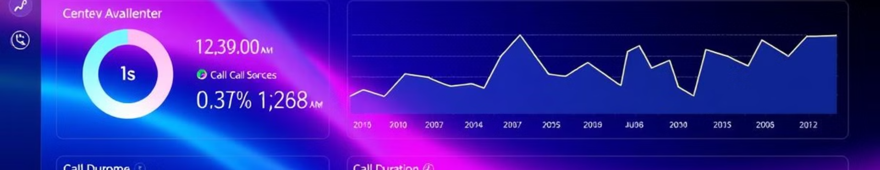



Dataset Overview
Agent Insights
Call Metrics
Call Details
Agent Name. Agent ID.
Queue Time. Call Duration.
Call Status. Time Bucket.
Comprehensive data to understand. It is essential for improving the customer journey.

Slide 4
Task Overview
1. Call Duration Analysis
3. Man Power Planning
2. Call Volume Analysis
4. Night Shift Planning

Slide 5
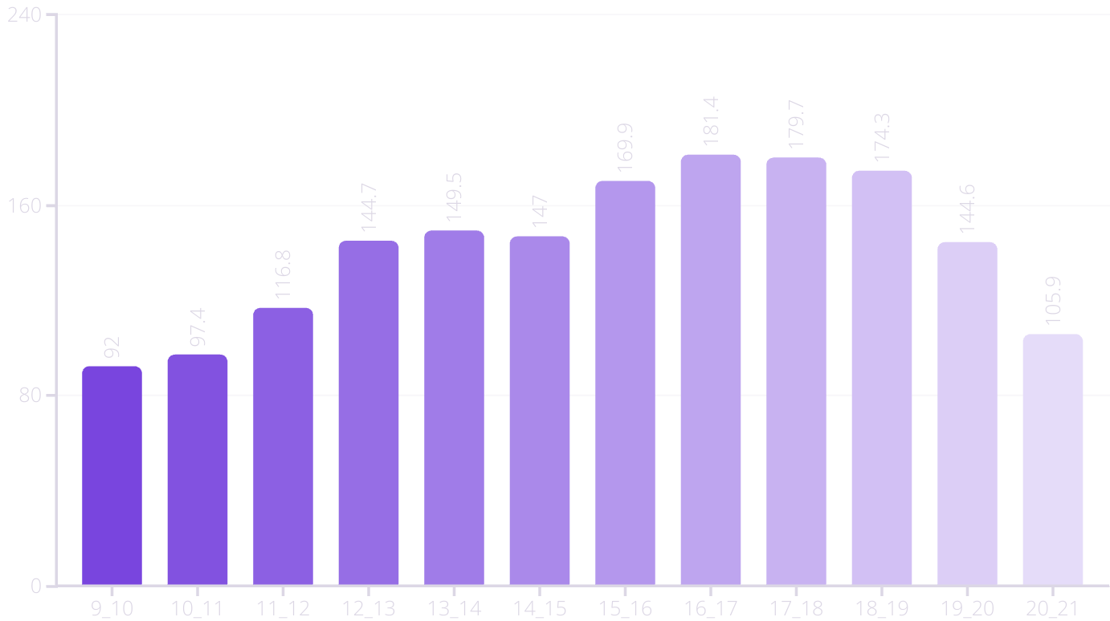
Average Call Duration Analysis
Peak call durations occur in evening. This data suggests staffing adjustments are needed during these times.

Slide 6
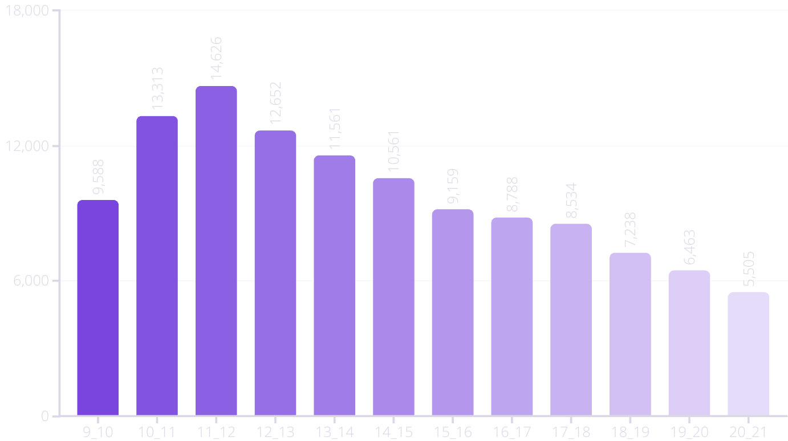
Call Volume Trends
Call volume peaks around lunchtime. This data drives effective resource allocation. Adjust staffing levels accordingly.

Slide 7

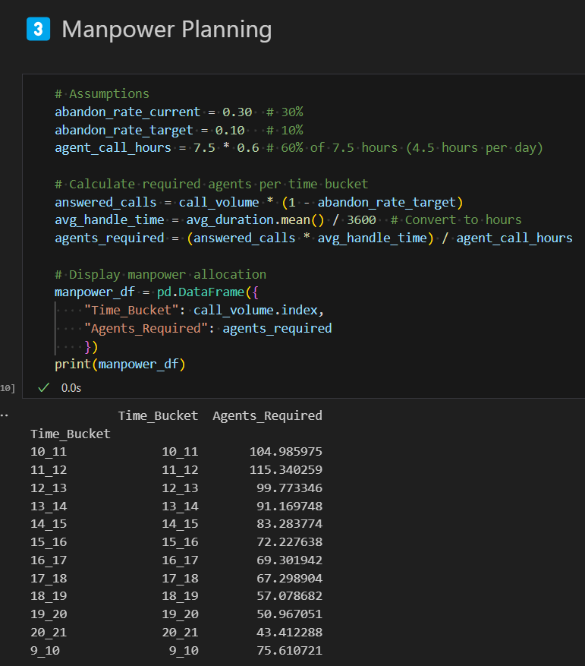
Manpower Planning for Reduced Abandon Rate
1
Current Abandon Rate
2
Target Abandon Rate
30% is too high.
Aim for 10% or less.
3
Optimal Staffing
Calculate agents per bucket.
Reduce abandon rates. Balance staffing requirements with projected call volumes.

Slide 8
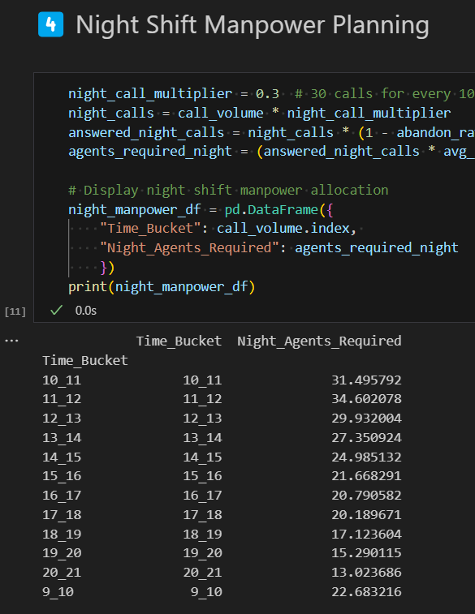

Night Shift Manpower Planning
1
Analyze Night Calls
Identify peak times.
2
Estimate Additional Agents
Address customer needs.
3
Improve CX
Provide 24/7 service.
Night shift staffing is crucial. Meet customer expectations. Enhance their overall experience.

Slide 9

Business Impact & Recommendations
Improved CX
Workforce Optimization
Happier customers.
Efficient resource use.
Reduced Abandon Rate
Less frustration.
These recommendations aim to enhance. They also improve operational efficiency.

Slide 10
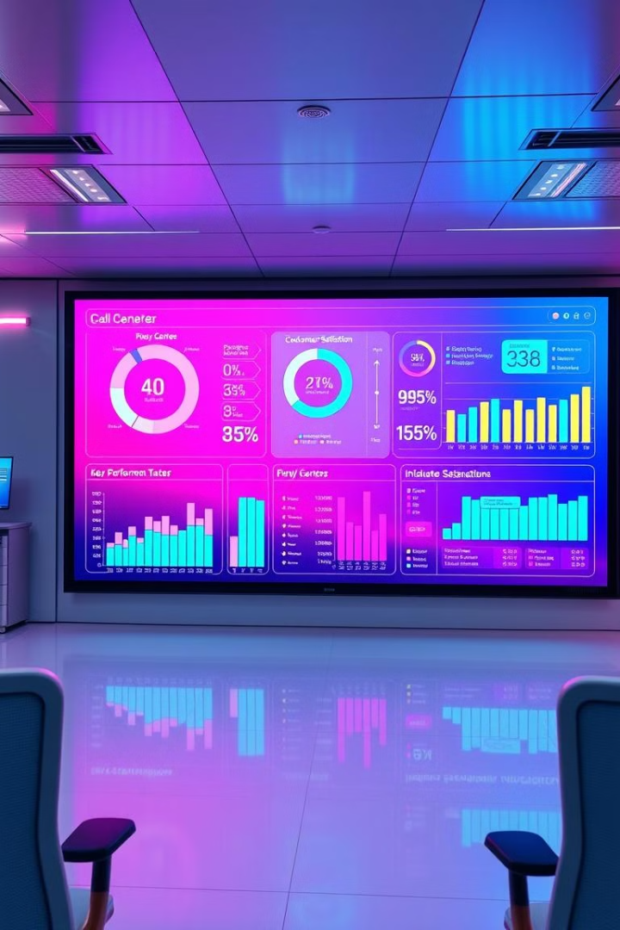
Key Takeaways & Next Steps
Prioritize CX analytics. It will transform your call center. Better customer service is your end goal.
Implement data-driven

Slide 11
Data Set & Video Link
Dataset
https://docs.google.com/spreadsheets/d/1aE90aHBpkW0oO1qE-wqKVfa2pDGWovWq/edit?gid=1468500971#gid=1468500971
Video Link
https://www.loom.com/share/5240687100f9446096f602bb5dfcaf7b?sid=c3fca49a-aa07-47e3-b54f-846e07ed38e9

